Slide 1

CS 533 INTRO TO DATA SCIENCE
Michael Ekstrand

Slide 2
INFORMATION AND ENTROPY

Slide 3

Learning Outcomes
Understand the relationship of information and uncertainty.
Use entropy to measure the amount of information in a signal.
Photo by Jon Tyson on Unsplash

Slide 4
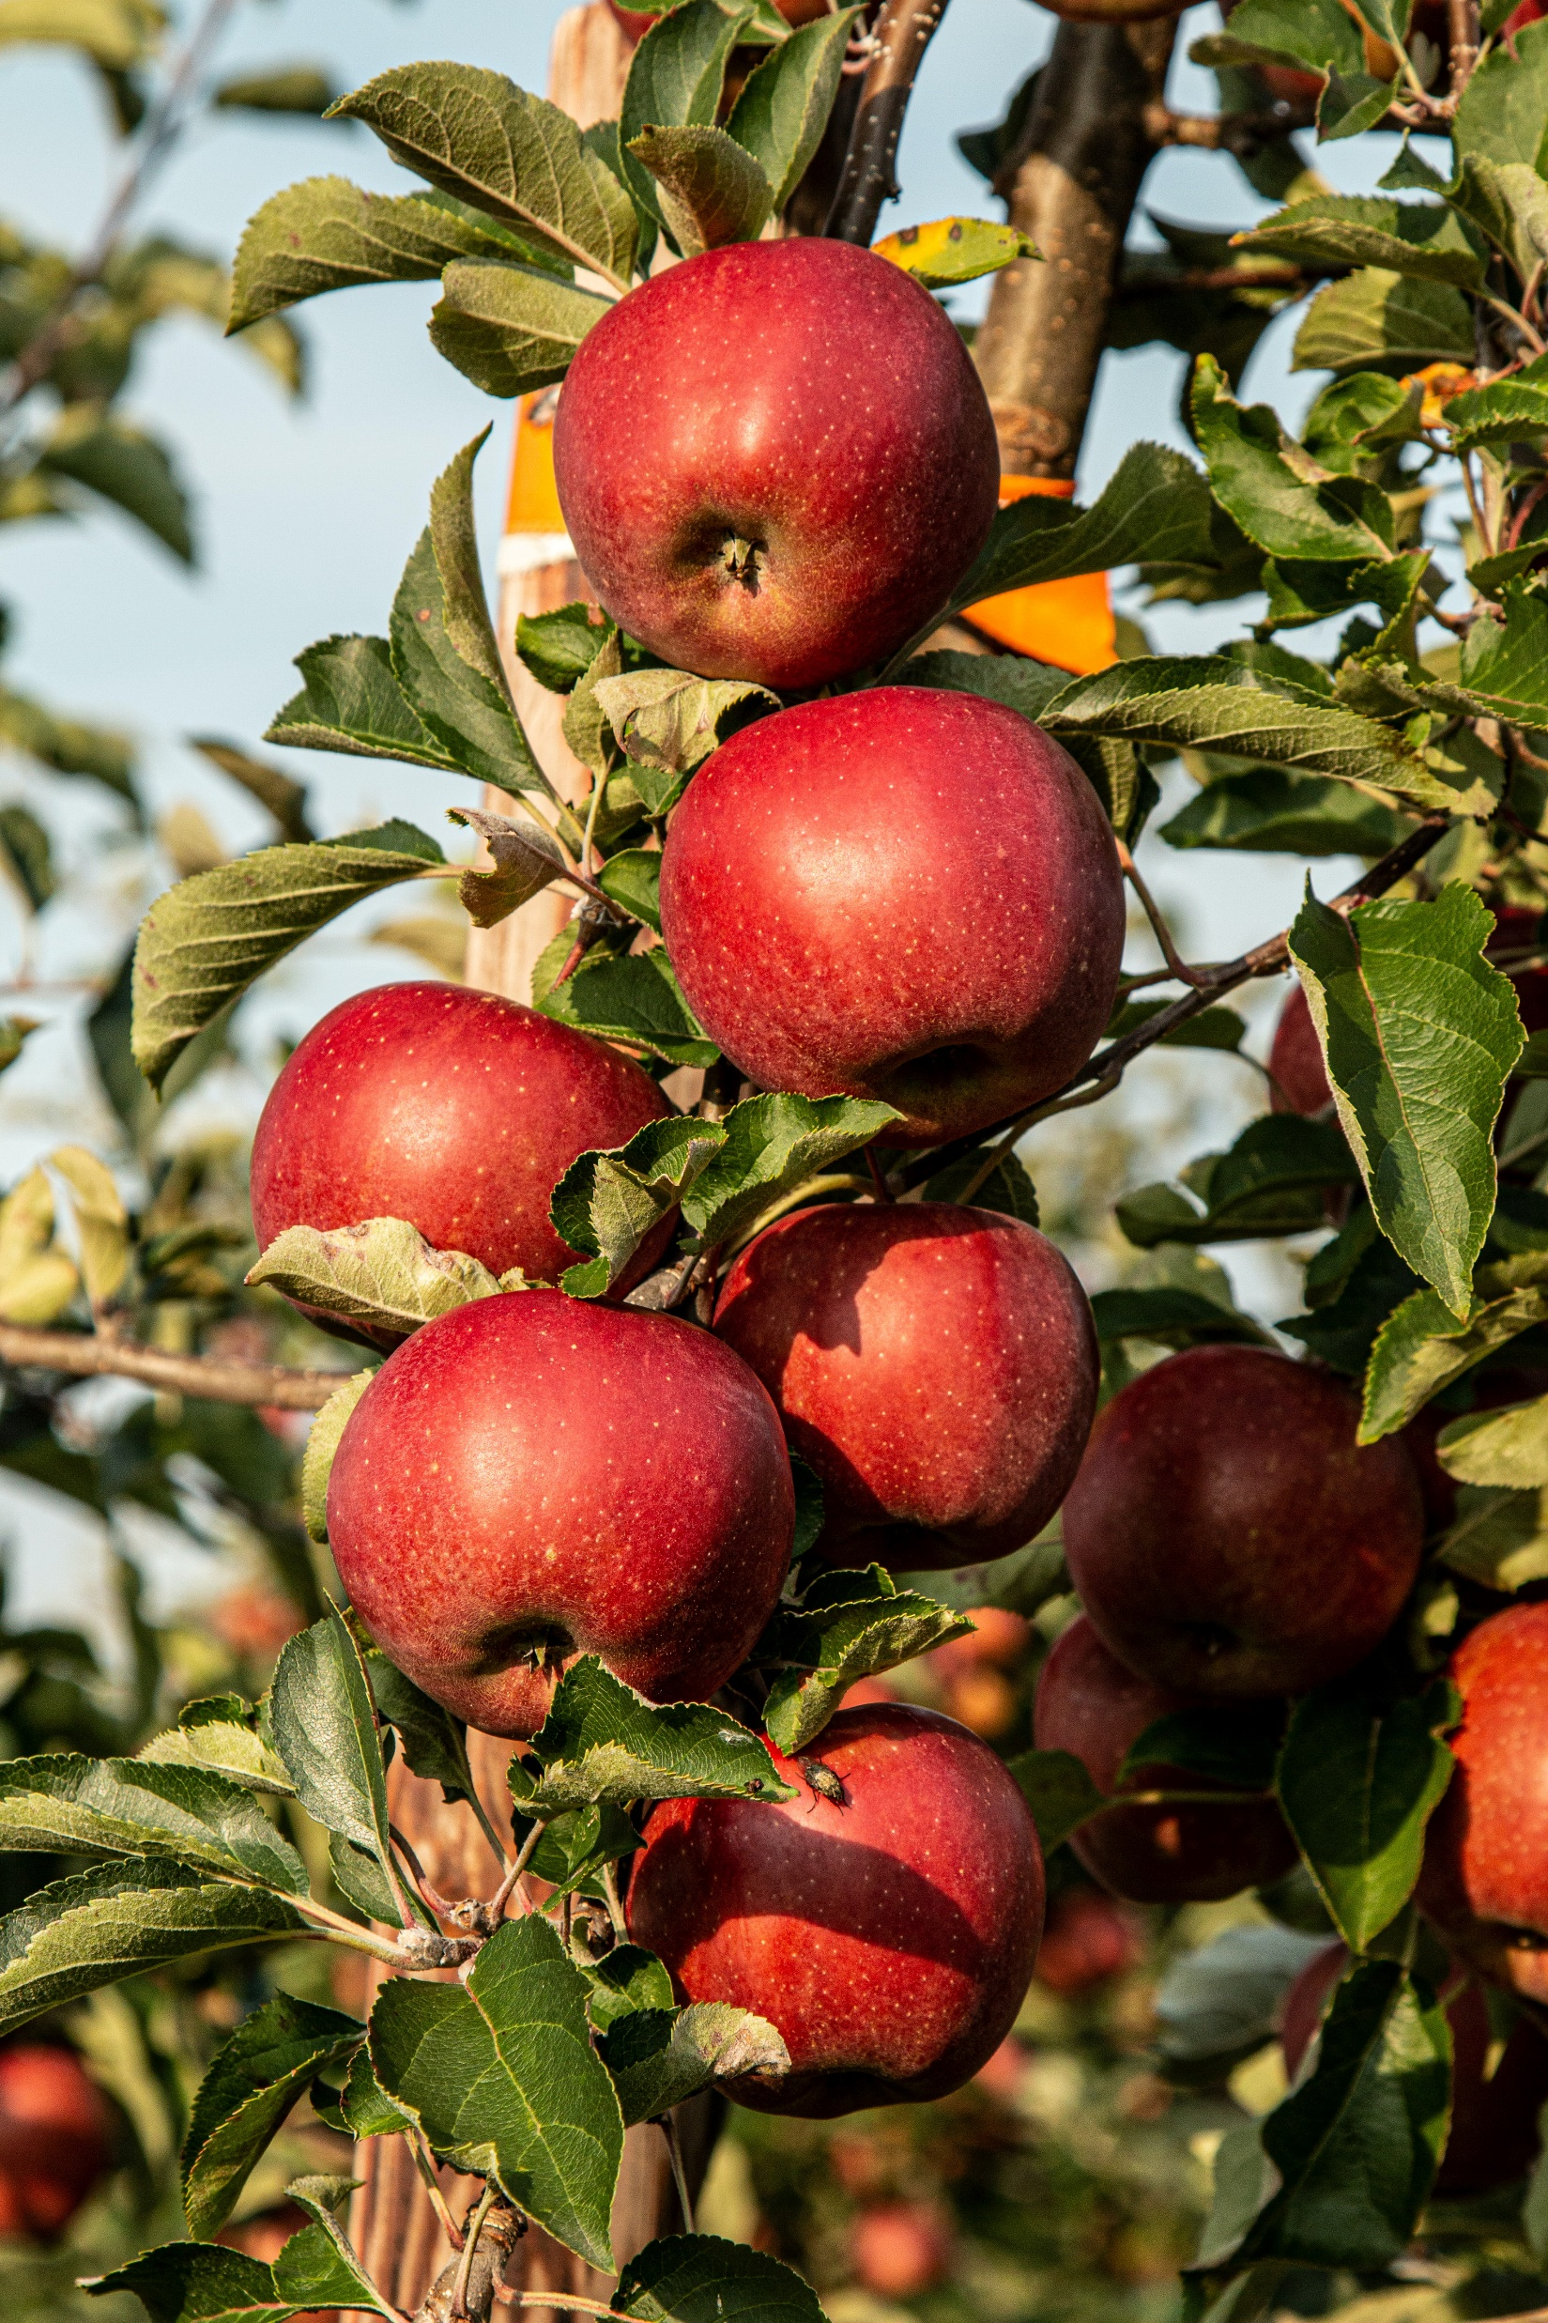
Messages and Information
“Apple”
How much information did I just give you?
What if you knew:
I would say an English word
I would say a fruit
I would say a regional fruit
I would name the fruit in the picture
Photo by Marek Studzinski on Unsplash

Slide 5
What is Information?
Information is the resolution of uncertainty.
The quantity of information is the amount of uncertainty it resolves.
Depends on background knowledge
Impossible to measure precisely in most cases

Slide 6
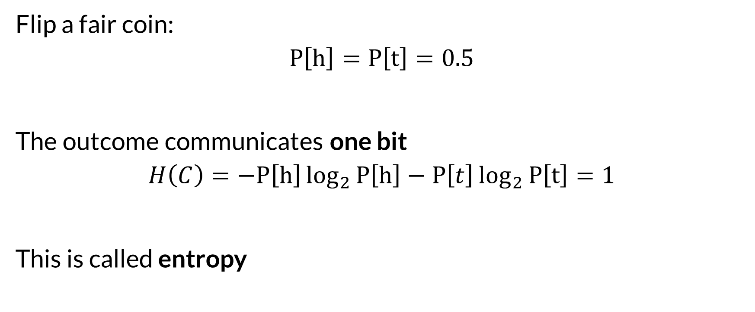

Bits
Flip a fair coin:
$$P\left[h\right]=P\left[t\right]=0.5$$
The outcome communicates one bit
$$H\left(C\right)=−P\left[h\right]\log_{2}{P\left[h\right]}−P\left[t\right]\log_{2}{P\left[t\right]}=1$$
This is called entropy

Slide 7
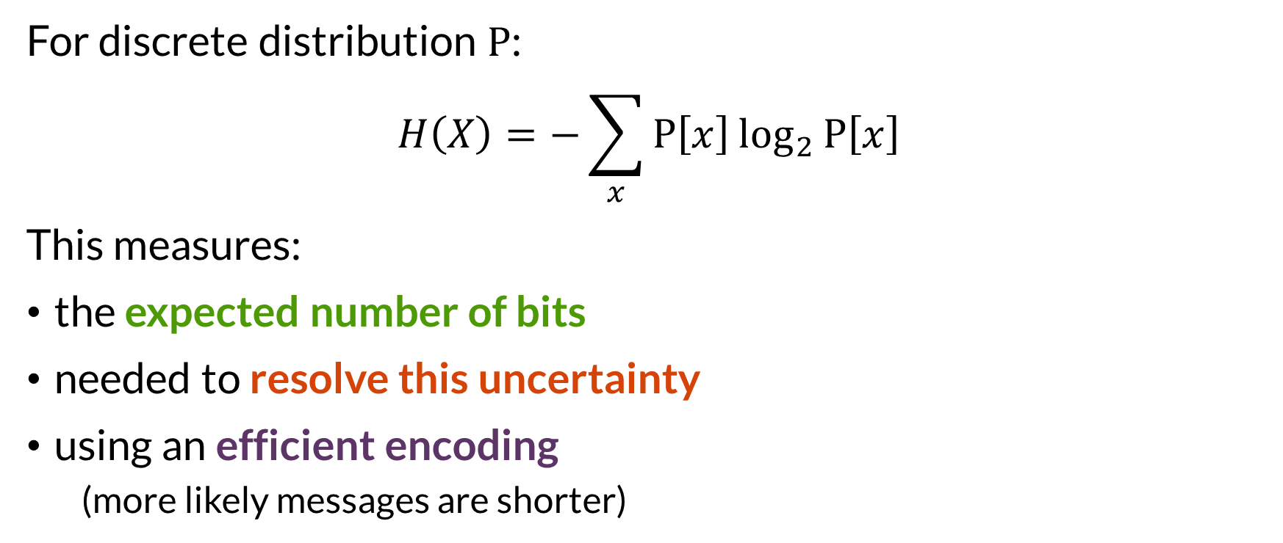
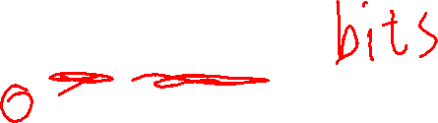
Entropy
For discrete distribution $P$:
$$H\left(X\right)=−\sum_{x}{P\left[x\right]\log_{2}{P\left[x\right]}}$$
This measures:
the expected number of bits
needed to resolve this uncertainty
using an efficient encoding
(more likely messages are shorter)

Slide 8
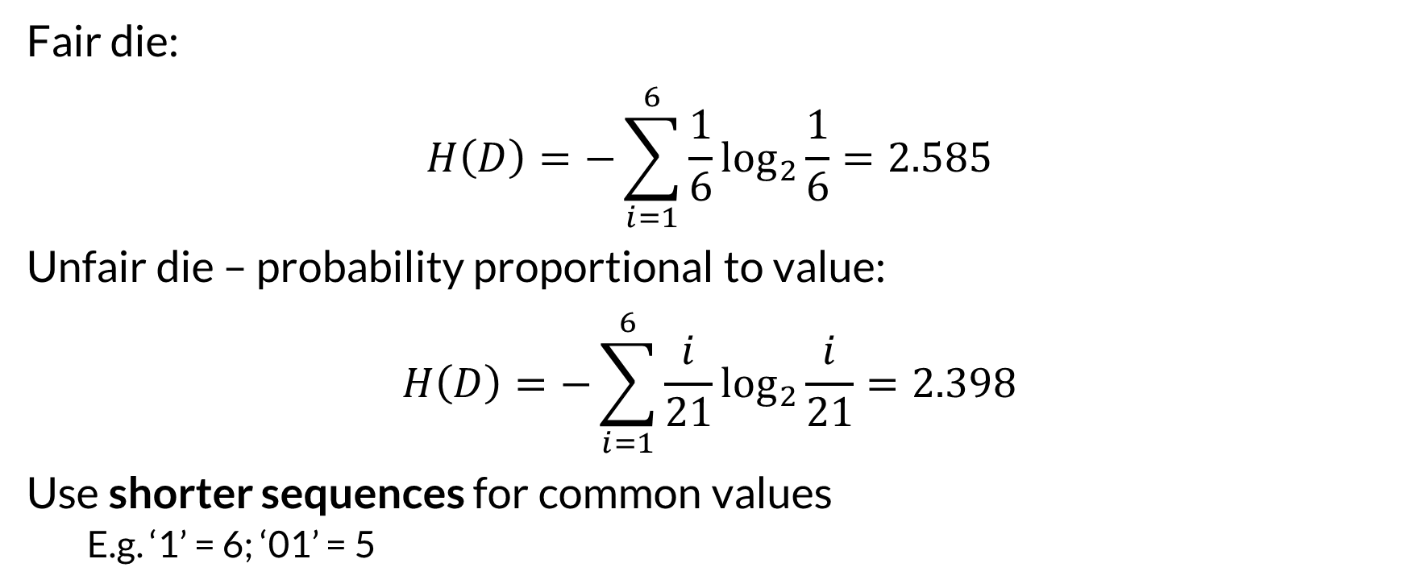
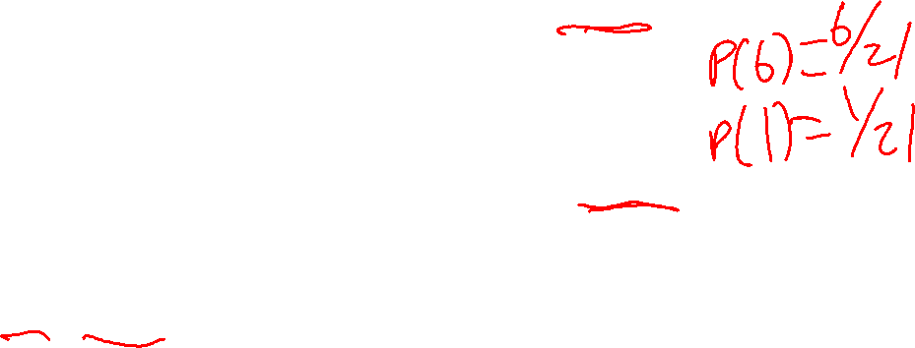
Entropy Applied
Fair die:
$$H\left(D\right)=−\sum_{i=1}^{6}{\frac{1}{6}\log_{2}{\frac{1}{6}}=2.585}$$
Unfair die – probability proportional to value:
$$H\left(D\right)=−\sum_{i=1}^{6}{\frac{i}{21}\log_{2}{\frac{i}{21}}=2.398}$$
Use shorter sequences for common values
E.g. ‘1’ = 6; ‘01’ = 5

Slide 9
Key Points
Entropy measures a distribution
Treats probability distribution as measure of certainty (or belief)
Very Bayesian perspective
Approximates information requirements
Usually don’t have a full, accurate probabilistic model

Slide 10
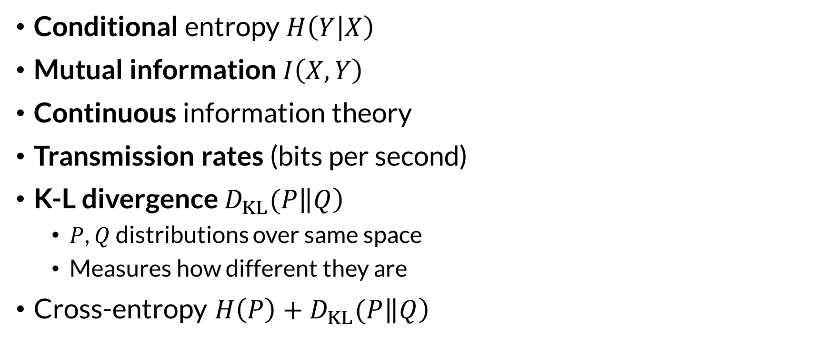
More Entropy
Conditional entropy $H\left(Y | X\right)$
Mutual information $I\left(X, Y\right)$
Continuous information theory
Transmission rates (bits per second)
K-L divergence $D_{KL}(P\left\|Q\right)$
$P$, $Q$ distributions over same space
Measures how different they are
Cross-entropy $H\left(P\right)+D_{KL}(P\left\|Q\right)$

Slide 11
Use Cases
Measures complexity of a distribution
Measure differences in distributions
Good for fitting distributions – minimize different to target

Slide 12

Wrapping Up
Information reduces uncertainty.
We measure uncertainty with entropy, the expected number of bits needed to efficiently resolve the uncertainty.
Derived metrics let us compare distributions.
Photo by Andrew Coop on Unsplash

